Slide 1


CHCDIV001
Work with diverse people (Release 1)

Slide 2


About this Unit of Competency
CHCDIV001 - Work with diverse people (Release 1)
This unit describes the skills and knowledge required to work respectfully with people from diverse social and cultural groups and situations, including Aboriginal and/or Torres Strait Islander people.

Slide 3


This unit applies to all workers. The skills in this unit must be applied in accordance with Commonwealth and State/Territory legislation, Australian/New Zealand standards and industry codes of practice.

Slide 4

Presentation Objectives
At the end of this session, you will be able to:
Reflect on your perspectives
Appreciate diversity and inclusiveness, and their benefits
Communicate with people from diverse backgrounds and situations
Promote understanding across diverse groups

Slide 5
Introduction
Culture is a learned set of values, behaviour, and knowledge.
It forms when a person or group's beliefs, behaviours, habits, and ongoing traditions are passed on from one generation to the next.
Cultural practices are normal, everyday behaviours among a group of people that identify with each other.
You belong to the group of people you share the same cultural practices with.
Individuals and groups of different cultures do not identify or perform the same behaviours.

Slide 6
The cultural difference between any two groups might include the following:
Thinking
Talking
Acting
Access to resources
Beliefs
Faith
Practices
Customs
Way of life
Art
Sport
Language
Food and eating
Geographical region
Education
Socioeconomic status
Laws
Class
Country of birth
Family structure
Sexuality
Spoken languages
Popular culture
Mass culture
Media culture

Slide 7
Concepts of Culture
In the study of culture and how it relates to human experiences, the following concepts are important to understand:
Cultural Sensitivity
It enables an individual to reflect on how their culture, worldview and actions impact others.
Cultural Awareness
It is a person’s understanding of the differences between oneself and people from other countries or backgrounds.

Slide 8
In the study of culture and how it relates to human experiences, the following concepts are important to understand:
Cultural Safety
It means providing a safe environment to people – where there is no assault, challenge or denial of their cultural identity and needs.
Cultural Competence
It is the ability to understand, communicate, and effectively interact with people across cultures.

Slide 9

Diversity
Diversity means variety.
In the workplace, having diverse people means having clients, coworkers, supervisors or managers from different cultures, races, genders, economic statuses, religions, philosophies, age brackets or political affiliations.

Slide 10

Reflect on Your Perspectives
CHCDIV001 - Work with diverse people (Release 1)

Slide 11
People have a natural tendency to feel a certain way about cultural groups.
Understanding cultural diversity will help you understand and control these tendencies.
Cultural diversity, as the name implies, is the presence of multiple cultural groups with varying traits within a society.
It is defined by the differences between the traits of the cultures involved and is visible in myriad ways.
The ultimate goal for any society is to bring out and utilise the diverse traits of these groups.
Reflect on Your Perspectives

Slide 12

Society must encourage its people to develop cultural awareness, safety and competence to reach this ultimate goal.
Whether the cultural experiences you created for others are positive or negative will depend on how your perspectives, biases, prejudices and ideas about culture affect your interactions with others.
Reflect on Your Perspectives

Slide 13

1.1 Identify and Reflect on Your Social and Cultural Perspectives and Biases

Slide 14
1.1 Identify and Reflect on Your Social and Cultural Perspectives and Biases
Social and cultural are related but have different meanings.
Cultural is an adjective that describes things related to a set of values, behaviour, and knowledge, while social is an adjective relating to community and society.
Your perspective is your view of or the particular attitude you have towards something, while your bias is your predisposition to favour one thing over another, usually in a way that is considered unfair.
Reflect on Your Perspectives

Slide 15
Perspectives and biases can be based on social or cultural factors.
Social perspective is your view of or the particular attitude you have towards a community, society or a group of people. Social bias is your predisposition to favour one community, society or group over another.
Cultural perspective is your view of or the particular attitude you have towards a set of values, behaviour, and knowledge. Cultural bias is your predisposition to favour one set of values, behaviour, and knowledge over another.
Reflect on Your Perspectives

Slide 16
Your perspectives and biases may affect your actions and behaviours as you carry out your job responsibilities, such as:
Communicating, either verbally or in writing, with people from diverse backgrounds
Complying with the duty of care policies
Collecting and providing various information
Providing support and assistance either with or without physical contact
Contacting family and carers
Reflect on Your Perspectives

Slide 17

Your perspectives and biases may affect your actions and behaviours as you carry out your job responsibilities, such as:
Respecting (care) for deceased people
Respecting another person’s property
Complying with food, medication or allergy requirements
Reflect on Your Perspectives

Slide 18
Reflecting and analysing your own experiences, thoughts and behaviour help in building awareness.
Awareness of your perspectives and biases provides the following benefits:
You will have more control over your actions and reactions in the workplace.
You can anticipate difficulties that you may encounter in the workplace.
You will be able to effectively resolve problems that can arise due to differences in racial and cultural backgrounds.
Reflect on Your Perspectives

Slide 19

Awareness of your perspectives and biases provides the following benefits:
Knowing your tendencies will aid you in developing your skills in observing, actively listening, and dealing with situations that may arise unexpectedly.
Seeking growth opportunities can address your weaknesses.
You will be able to demonstrate a more positive attitude towards all people.
Reflect on Your Perspectives

Slide 20
1.1.1 Identifying and Reflecting on Your Own Cultural Perspectives and Biases
Knowing your own culture can provide great insights into why you feel a certain way or why you grew up to think of others in a certain manner and help identify what you need to do to correct some misconceptions or negative attitudes.
Take note that culture is not always clearly defined. Having the same ethnic background or speaking the same language does not mean having the same cultural identity.
Reflect on Your Perspectives

Slide 21
Identifying Cultural Perspectives
Identifying your own cultural perspectives is the process of determining your view of or the particular attitude you have towards a set of values, behaviour, and knowledge.
The following are some tips for identifying cultural perspectives:
Make a list of the things you know about your and others’ cultures.
Notice how you react or behave in different situations.
Examine which activities you prefer and avoid.
Reflect on Your Perspectives

Slide 22

The following are some tips for identifying cultural perspectives:
Recognise the values you learned from your family or community.
Determine which of the teachings in your different communities you adhere to.
Reflect on Your Perspectives

Slide 23
Reflecting on Cultural Perspectives
Reflecting on your own cultural perspectives is the process of understanding your view of or the particular attitude you have towards a set of values, behaviour, and knowledge by way of serious thought.
To reflect on your cultural perspectives, you may ask yourself the following questions:
What language do you speak when interacting with these other people? Are you able to speak with them freely? What are things that you can and cannot discuss?
Do you feel obligated to spend time on these activities? Do you have freedom in choosing what to do and who to do it with?
Reflect on Your Perspectives

Slide 24
To reflect on your cultural perspectives, you may ask yourself the following questions:
What are your community’s policies? What kinds of laws and ordinances are enforced on you and other members of your community?
How does your community react to certain news or events? How does your community address problems or issues?
What values does your community teach its children? What lessons can be learned from your community’s stories, songs or movies?
What recent experiences show cultural heritage affecting my interaction with others?
Reflect on Your Perspectives

Slide 25
Identifying Cultural Biases
Identifying your own cultural biases is the process of determining your predisposition to favour one set of values, behaviour, and knowledge over another.
The following are some tips for identifying your cultural biases:
Determine the values and ideals you uphold and disregard.
Compare your beliefs with others’ beliefs. If possible, you may ask others about their beliefs.
Reflect on Your Perspectives

Slide 26

The following are some tips for identifying your cultural biases:
Be aware of your emotions about things and activities that are related to cultures.
Try to put yourself in the position of others. You may see the difference between your and others’ perspectives.
Compare how you and others react to different situations.
Reflect on Your Perspectives

Slide 27
Reflecting on Cultural Biases
Reflecting on your own cultural biases is the process of understanding your predisposition to favour one set of values, behaviour, and knowledge over another by way of serious thought.
To reflect on your cultural biases, you may ask yourself the following questions:
How does cultural background affect my daily experiences?
What do you see each day? What sounds do you regularly hear, and what events regularly occur? Do I avoid particular cultural activities?
Reflect on Your Perspectives

Slide 28
To reflect on your cultural biases, you may ask yourself the following questions:
Are you open to learning about and understanding different cultural practices, customs and perspectives?
What values do you teach to the younger generation?
Are there times that I judge, approach or avoid a person based on their cultural background?
Are there times that I feel that my or others’ cultures are superior or inferior?
What ideas do you refer to when forming thoughts, ideas or opinions? What philosophies do you adhere to? What basic teachings guide your actions? Do I reject other philosophies?
Reflect on Your Perspectives

Slide 29

1.1.2 Identifying and Reflecting on Your Own Social Perspectives and Biases
The focus of cultural perspectives and biases are the different sets of values, beliefs and ideas, while social perspectives and biases focus on society or community.
Identifying Social Perspectives
Identifying your own social perspectives is the process of determining your view of or the particular attitude you have towards a community, society or a group of people.
Reflect on Your Perspectives

Slide 30
The following are some tips for identifying social perspectives:
Make a list of the things you know about your and others’ communities.
Notice the kinds of people you want to be with and consider the groups where you belong.
Examine which group of people you prefer and avoid, including how you regard different societies or communities, including your own
Reflect on Your Perspectives

Slide 31
Reflecting on Social Perspectives
Reflecting on your own social perspectives is the process of understanding your view of or the particular attitude you have towards a community, society or a group of people by way of serious thought.
To reflect on your social perspectives, you may ask yourself the following questions:
Who are the people that you spend the most time with? Who makes up your social groups, i.e. families, circle of friends and other social networks?
Reflect on Your Perspectives

Slide 32
To reflect on your social perspectives, you may ask yourself the following questions:
Where do you spend the most time in? Do you dedicate time to church activities, working with kids, attending political rallies, working on your fitness, or communicating with members of an exclusive group?
Do you feel obligated to spend time with these people? Are there legal or social expectations of how to spend your time?
What kinds of buildings or infrastructures are there in your environment?
Reflect on Your Perspectives

Slide 33
To reflect on your social perspectives, you may ask yourself the following questions:
Who do you consult with when you have problems? What are the places, and who are the people that you can turn to whenever you need support or have questions?
What experiences have shaped my ideas about social groups?
What are my beliefs and ideas about my racial heritage? What makes people from my cultural group unique?
What are my beliefs and ideas about people in the same social group as me?
What do I believe about people from different social groups in my industry?
Reflect on Your Perspectives

Slide 34
Identifying Social Biases
Identifying your own social biases is the process of determining your predisposition to favour one community, society or group over another.
The following are tips for identifying social biases:
Determine which society or community you have high and low regard for.
Compare your community with others’ communities.
Be aware of your emotions about different communities.
Reflect on Your Perspectives

Slide 35

The following are tips for identifying social biases:
Try to put yourself in the position of others. You may see the difference between your and others’ perspectives.
Compare how you and others react to different communities.
Reflect on Your Perspectives

Slide 36
Reflecting on Social Biases
Reflecting on your own social biases is the process of understanding your predisposition to favour one community, society or group over another by way of serious thought.
To reflect on your social biases, you may ask yourself the following questions:
When I see a person of a different social or cultural group, is there a change in my mood or disposition?
Am I more likely or willing to provide better service to people of certain groups?
Reflect on Your Perspectives

Slide 37
To reflect on your social biases, you may ask yourself the following questions:
What is your reaction to news about your or others’ communities?
What groups do you refer to when forming thoughts, ideas or opinions?
What positive and negative traits do I attribute to certain social groups?
What do I think of people outside my social or cultural group?
Reflect on Your Perspectives

Slide 38
To reflect on your social biases, you may ask yourself the following questions:
How do my age, sex, gender, wealth, and racial background affect my daily experiences?
What recent experiences show my age, sex, gender, wealth and race affecting my interaction with others?
Reflect on Your Perspectives

Slide 39
1.1.3 Identifying How Your Culture Affects Different People and Groups
Your reflection should give you a clearer picture of your culture’s attitudes, language, policies and structures.
Depending on your culture, there can be varying effects or impacts on another person:
Differences in language may affect the communication of a person with you and other community members.
Differences in culture may restrict a person when solving issues or addressing problems.
Reflect on Your Perspectives

Slide 40
Depending on your culture, there can be varying effects or impacts on another person:
The person may receive benefits from certain policies, but they may also be subjected to discrimination or unfair treatment.
The person may not receive the same benefits as others due to structural differences.
How your culture affects persons around you will differ on a case-to-case basis.
It depends on specific differences between your culture and the culture of others.
Reflect on Your Perspectives

Slide 41

1.2 Work with Awareness of Own Limitations in Self and Social Awareness

Slide 42
1.2 Work with Awareness of Own Limitations in Self and Social Awareness
Social awareness entails understanding how a person’s social traits may inform their values, behaviour, beliefs and basic assumptions.
Limitations are your personal shortcomings or failures in understanding other cultures.
Limitations in self include your perspectives, biases and tendencies when interacting with others.
It can be easy to fall into a false sense of awareness.
Social awareness involves exploring social issues and recognising that everyone is shaped by their sex, gender, age, economic class and race.
Reflect on Your Perspectives

Slide 43

To become an expert in social traits or to have all the answers in a small box is unnecessary and impractical.
It is important to remember that individuals cannot be defined solely by their social norms or patterns.
Reflect on Your Perspectives

Slide 44
The following are key considerations of social awareness:
Awareness of one’s own social and cultural influences before learning about others is important for any successful endeavour.
The processes involved in understanding the beliefs and behaviour of people can vary considerably within each social group.
Making assumptions or generalisations on the effects of social influences should be avoided.
Reflect on Your Perspectives

Slide 45
The following are key considerations of social awareness:
You must view and evaluate other people’s behaviour and beliefs using the standards of their group.
Understanding how people adopt new practices and retain old practices can vary within social groups.
Not all people identify with religious backgrounds or cultures.
Reflect on Your Perspectives

Slide 46

To better understand your limitations, look back at your answers to the reflection questions in the previous subchapter.
Try to see if you can provide answers to these new questions:
What do I already know or believe about social and cultural groups?
When thinking about the lives of the people in different social and cultural groups, what do I not understand yet?
Reflect on Your Perspectives

Slide 47
Try to see if you can provide answers to these new questions:
Are there any customs or practices that I need to learn about?
Are there any aspects of their daily lives that I have not yet observed or read about?
What aspects of my life do people from outside my social and cultural group find confusing, different or peculiar?
Can there be aspects in the lives of others that I find different and peculiar, too?
Reflect on Your Perspectives

Slide 48
To work with an awareness of your limitations, remember to do the following:
Admit and fully realise the extent of your knowledge of social and cultural groups and backgrounds.
Never pretend to know something that you do not know.
Coordinate with your workplace to address your limitations.
Assistances made by companies to address limitations in cultural awareness must never be considered unfair and partial only to people of diverse backgrounds.
Never think that any one cultural group should conform to another.
Reflect on Your Perspectives

Slide 49
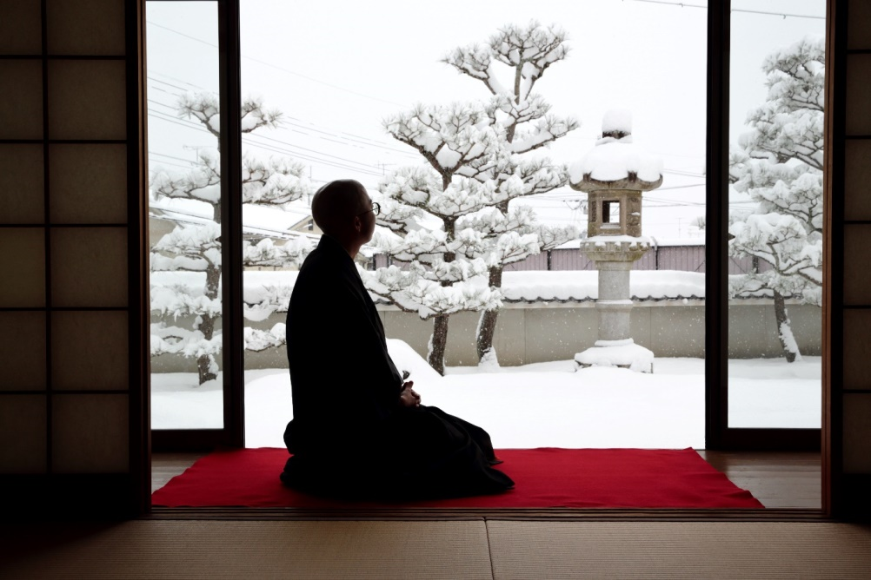
1.3 Reflect on Your Ability to Work Inclusively and Understand Others

Slide 50

1.3 Reflect on Your Ability to Work Inclusively and Understand Others
As a worker, you are expected to comply with your organisation’s procedures in your daily interaction with colleagues and clients from diverse backgrounds.
To work inclusively means to work in a way that upholds and protects the rights and dignity of all persons.
On the other hand, understanding others means accounting for difficulties or issues arising from differences in culture and responding to these difficulties and issues appropriately.
Reflect on Your Perspectives

Slide 51
1.3.1 Inclusion Through Cultural Safety
Culturally safe practices include actions that recognise and respect the cultural identities of others.
Working inclusively and understanding others are accomplished by observing cultural safety at all times.
Alternatively, culturally unsafe practices diminish, demean or disempower an individual's cultural identity and well-being.
Culturally safe practices allow organisations to create culturally inclusive programs.
Reflect on Your Perspectives

Slide 52
In the workplace, working inclusively can involve doing the following:
Reflecting on your own culture, attitudes and beliefs about others
Using clear, value-free, open and respectful communication
Developing relationships based on trust and respect
Recognising and avoiding stereotypical barriers
Being prepared to engage in a two-way dialogue where knowledge is shared
Understanding the influence of culture shock
Strongly implementing and following policies and procedures on discrimination
Reflect on Your Perspectives

Slide 53
To provide culturally appropriate services, workers must ensure that the decisions made and services delivered:
Build on the person’s strengths and are tailored to each person’s needs
Recognise the significance of extended families, kinship and cultural ties during planning and service delivery
Respect and are sensitive to the person’s culture and traditions
Preserve or enhance their sense of identity and connections with their family and community
Reflect on Your Perspectives

Slide 54
To fulfil these responsibilities, all workers must:
Develop an understanding of kinship systems, community histories and dynamics
Build relationships with cultural groups based upon respectful communication and appropriate professional connections
Identify key stakeholders within communities. Then, work in partnership with significant community members and service providers
Work collaboratively with local government and non-government agencies to provide planned, coordinated services.
Reflect on Your Perspectives

Slide 55

Culturally Inclusive Programs
A culturally inclusive program:
Ensures that all people retain their right to express and develop their cultural identity
Remains progressive and emphasises the growth of cultures while protecting the self-esteem and identity of all people
Reflect on Your Perspectives

Slide 56
A culturally inclusive program:
Recognises the unique contributions of Aboriginal and Torres Strait Islander people, as well as other people from other cultures, to the society of Australia;
Provides positive representation for people of diverse cultures and backgrounds
Focuses on contemporary issues while staying respectful of the history of Australians and the values within it
Has clearly defined philosophy, policies and procedures. They must be rooted in the various legal and ethical bases that apply to the organisation and industry.
Reflect on Your Perspectives

Slide 57

1.3.2 Inclusion and Human Rights
Human rights are based on the obligation to yourself and others as human beings to uphold liberty, dignity, equality, fairness, respect, and independence.
On the other hand, human needs pertain to basic means of survival: food, shelter, water, clothing, and the like.
Reflect on Your Perspectives

Slide 58
Human rights advocates for all people to have satisfactory access to their human rights.
Human rights are inalienable because they cannot be taken away.
The Universal Declaration of Human Rights (UDHR) is:
A timeless document that outlines the rights and freedoms everyone is entitled to
A framework for workers across many service sectors and establishes fundamental human rights that must be uniformly safeguarded for all people
A guide in providing services to ensure that all people are given equal opportunities in life, liberty, education, health, and security
Reflect on Your Perspectives

Slide 59
The following are the seven core treaties recognised by the government:
International Covenant on Civil and Political Rights (ICCPR)
International Covenant on Economic, Social and Cultural Rights (ICESCR)
International Convention on the Elimination of All Forms of Racial Discrimination (CERD)
Convention on the Elimination of All Forms of Discrimination Against Women (CEDAW)
Convention against Torture and Other Cruel, Inhuman or Degrading Treatment or Punishment (CAT)
Convention on the Rights of the Child (CRC)
Convention on the Rights of Persons with Disabilities (CRPD)
Reflect on Your Perspectives

Slide 60
Some relevant instruments are provided below:
ICERD International Convention on the Elimination of All Forms of Racial Discrimination
ICCPR International Covenant on Civil and Political Rights
ICESCR International Covenant on Economic, Social and Cultural Rights
CEDAW Convention on the Elimination of All Forms of Discrimination against Women
Reflect on Your Perspectives

Slide 61
Some relevant instruments are provided below:
CAT Convention against Torture and Other Cruel, Inhuman or Degrading Treatment or Punishment
CRC Convention on the Rights of the Child
ICMW International Convention on the Protection of the Rights of All Migrant Workers and Members of Their Families
CPED International Convention for the Protection of All Persons from Enforced Disappearance
Reflect on Your Perspectives

Slide 62
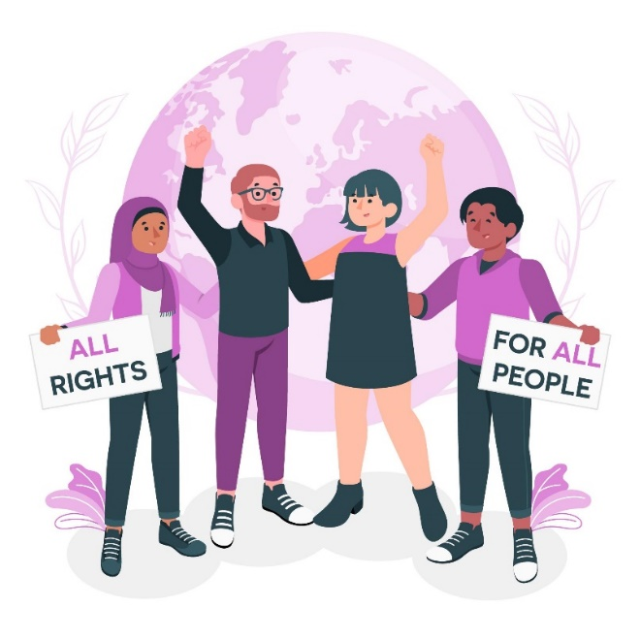
Some relevant instruments are provided below:
CRPD Convention on the Rights of Persons with Disabilities
ICCPR-OP1 Optional Protocol to the International Covenant on Civil and Political Rights
ICCPR-OP2 Second Optional Protocol to the International Covenant on Civil and Political Rights, aiming at the abolition of the death penalty
Reflect on Your Perspectives

Slide 63
Some relevant instruments are provided below:
OP-CEDAW Optional Protocol to the Convention on the Elimination of Discrimination against Women
OP-CRC-AC Optional protocol to the Convention on the Rights of the Child on the involvement of children in armed conflict
Declaration on the Elimination of All Forms of Intolerance and of Discrimination Based on Religion or Belief
Reflect on Your Perspectives

Slide 64
Some relevant instruments are provided below:
OP-CRC-SC Optional protocol to the Convention on the Rights of the Child on the sale of children, child prostitution and child pornography
OP-CRC-IC Optional Protocol to the Convention on the Rights of the Child on a communications procedure
OP-CAT Optional Protocol to the Convention against Torture and Other Cruel, Inhuman or Degrading Treatment or Punishment
Reflect on Your Perspectives

Slide 65
Some relevant instruments are provided below:
OP-CRPD Optional Protocol to the Convention on the Rights of Persons with Disabilities
ICESCR – OP Optional Protocol to the Covenant on Economic, Social and Cultural Rights
Reflect on Your Perspectives

Slide 66
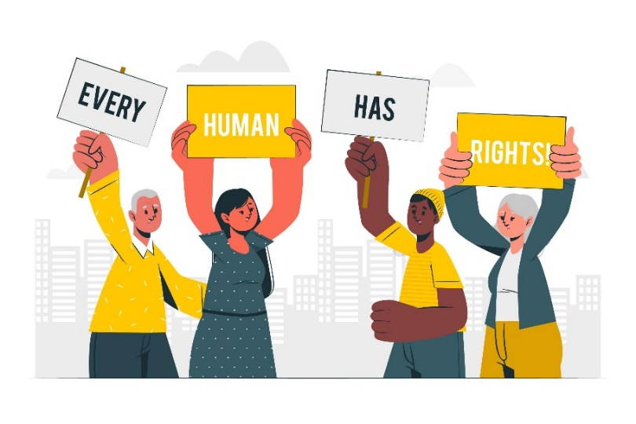
Additional human rights standards and conventions include:
International Labour Organization (ILO) Labour Standards
International Labour Organization (ILO) Declaration on Fundamental Principles and Rights at Work
International Labour Organization (ILO) Forced Labour Convention
Reflect on Your Perspectives

Slide 67
Additional human rights standards and conventions include:
Freedom of Association and Protection of the Right to Organise Convention
Right to Organise and Collective Bargaining Convention
Equal Remuneration Convention
Abolition of Forced Labour Convention
Discrimination (Employment and Occupation) Convention
Minimum Age Convention
Worst Forms of Child Labour Convention
Reflect on Your Perspectives

Slide 68
As a worker, your role is to use these instruments properly to ensure that human rights are upheld in the workplace. Doing this may involve actions and steps such as:
Using technology to accommodate the needs of different clients and promote their independence
Providing equal access to materials and equipment so that all clients are given the best possible support
Providing the appropriate setting for care and support to ensure that clients are comfortable
Reflect on Your Perspectives

Slide 69

As a worker, your role is to use these instruments properly to ensure that human rights are upheld in the workplace. Doing this may involve actions and steps such as:
Listening to clients when they share their needs and working with them to ensure that the organisation provides for these needs.
Reflect on Your Perspectives

Slide 70
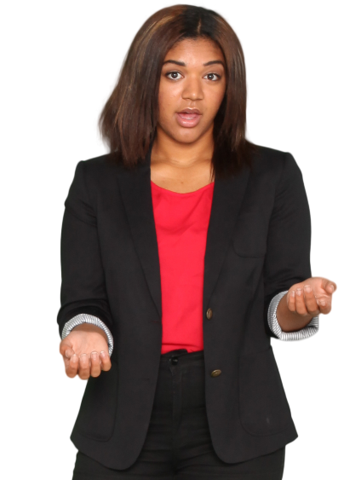
The requirements for providing the proper instruments are based on human rights legislation and guidelines created and provided by the Australian Human Rights Commission (AHRC).
The AHRC is the national authority for human rights.
The AHRC has the following functions:
Address, investigate and conciliate complaints of discrimination
Reflect on Your Perspectives

Slide 71
The AHRC has the following functions:
Examine and investigate the enactment of the different pieces of anti-discrimination legislation and other commonwealth and local legislation
Inquire on organisation practices, policies or behaviours that breach a person or group’s human rights
Promote awareness of human rights and research on programs that can aid in this endeavour
Report on any investigations or findings as necessary
Reflect on Your Perspectives

Slide 72
The Australian Human Rights Framework (AHRF):
Guides the AHRC’s and other commissions' actions
Provides a more concrete and definite meaning to various human rights concepts
Does not include a human rights act
Aims to make information about human rights available through education
Established a committee on human rights that reviews existing legislation for human rights compliance
Reflect on Your Perspectives

Slide 73
The framework has five steps in promoting human rights. These are:
Reaffirming the government’s commitment to promoting awareness of human rights
Educating the community for a better understanding of human rights
Engaging with the international community to enhance the protection of human rights locally
Protecting human rights by establishing a committee on human rights
Respecting human rights through compliance review of legislations
Reflect on Your Perspectives

Slide 74
Human Rights Approaches
Compliance with human rights requirements means that work practices must be aligned with human rights principles and laws.
You must uphold and protect the human rights of your workers, colleagues and clients.
In the workplace, legislation and guidelines translate to obligations you must comply with.
Reflect on Your Perspectives

Slide 75
The following are some examples of how you can apply human rights to your workplace approaches:
Implement workplace policies and procedures to address barriers in the provision of services to clients
Pursue development opportunities on how to provide services based on human rights principles
Plan and provide support in consideration of the individual needs and preferences of clients
Get the opinion of clients and work with them to ensure that their needs are addressed
Evaluate how you and other workers interact with clients to ensure that the rights of clients are respected and upheld
Reflect on Your Perspectives

Slide 76
1.3.3 Understanding Legal and Ethical Considerations
Organisations and workers looking to offer services to diverse people can find it daunting to account for the many different variables that may affect their services.
The easiest and most effective way to account for these relevant variables is to comply with the legal and ethical requirements and considerations provided by your local authorities, your state/territory government, the national commonwealth and the international community.
Reflect on Your Perspectives

Slide 77

The following are some requirements and considerations that you and other support workers must be familiar with:
Anti-discrimination requirements and considerations
Human rights requirements and considerations
Rights and responsibilities of workers, employers and clients
Reflect on Your Perspectives

Slide 78
Anti-discrimination requirements and considerations
Discrimination means giving unfair treatment to people due to their identity or characteristics, including age, disability, race, religion, sex, and gender.
The following federal legislation outlaws discrimination in various areas of life:
Age Discrimination Act 2004
Disability Discrimination Act 1992
Racial Discrimination Act 1975
Sex Discrimination Act 1984
Reflect on Your Perspectives

Slide 79
Age Discrimination Act 2004
The Act promotes age diversity by eliminating discrimination against persons on the grounds of age in work, education, and access to goods, services, and facilities.
Disability Discrimination Act 1992
The act ensures that persons with disabilities have the same rights to equality before the law as the rest of the community. It eliminates discrimination against persons on the ground of disability.
Reflect on Your Perspectives

Slide 80
Racial Discrimination Act 1975
The act prohibits racial hatred (sometimes called vilification) based on a person’s race, colour, national or ethnic origin).
Sex Discrimination Act 1984
The act makes it unlawful to discriminate against a person because of sex, marital status, or pregnancy. Sexual harassment and termination from employment because of family responsibilities are considered unlawful.
Reflect on Your Perspectives

Slide 81
Your State/Territory’s Anti-Discrimination Legislation
Individual states and territories also have laws against discrimination.
The federal and state/territory’s legislations on discrimination specifies what counts as discrimination and what should be done and avoided or prevented in the workplace.
Employment, including applying for work, enjoying benefits provided by the employer and joining unions
Education, including admission to educational institutions
Access to any premises open to the public
Reflect on Your Perspectives

Slide 82

The federal and state/territory’s legislations on discrimination specifies what counts as discrimination and what should be done and avoided or prevented in the workplace.
Access to goods, services, facilities and membership in clubs or sports organisations
Accommodation such as applying for accommodations or being evicted from their residence
Land, such as disposal of land through a will
Reflect on Your Perspectives

Slide 83
Through these pieces of legislation, it becomes unlawful to discriminate against someone on the grounds of age, sex, race or disability in the following areas:
Representation in advertisements
Services and benefits received from the commonwealth law and programs and all representatives and administrators of said laws and program
These pieces of legislation set penalties for unlawful discrimination acts, which allow justice to be upheld in cases where verified actions caused discrimination.
Reflect on Your Perspectives

Slide 84

Various ethical considerations
They prohibit discrimination.
They can be found in many sources, such as codes of conduct, codes of practice and your organisation’s policies or procedures.
They can also be unwritten rules followed by workers in your industry due to a common understanding of what is right and fair.
Reflect on Your Perspectives

Slide 85
The following are examples of ethical considerations and responsibilities that you may need to comply with:
Race discrimination – Individual workers must honour the preferences, traditions and practices of people from varying racial backgrounds, so long as it does not conflict with any organisational policies.
Disability Discrimination – Through this responsibility, workers are expected to prioritise the health, safety and well-being of people with disability that are under their care. They are required to follow relevant mandatory reporting requirements.
Reflect on Your Perspectives

Slide 86
The following are examples of ethical considerations and responsibilities that you may need to comply with:
Sex Discrimination – A worker must treat all workers of both sexes with the same uniform level of respect and courtesy. In the workplace, persons of varying sexes and genders must work harmoniously.
Reflect on Your Perspectives

Slide 87
The following are some relevant legislation, codes of practice and organisational policies and procedures that will affect workplaces across different industries:
Codes of Practice
Industry | Code of Practice
Retail and Business Services | Australian Competition and Consumer Commission (ACCC) Mandatory Industry Codes
Community Services | Australian Community Workers Association (ACWA) Codes of Ethics and Practice
Financial Services | Australian Financial Complaints Authority Banking Code of Practice
Reflect on Your Perspectives

Slide 88
The following are some relevant legislation, codes of practice and organisational policies and procedures that will affect workplaces across different industries:
Codes of Practice
Industry | Code of Practice
Construction and Plumbing Services | Safework Australia Model Code of Practice
Creative Arts and Culture Industry | National Association for the Visual Arts Code of Practice for the Professional Visual Arts, Craft and Design Sector
Property Services | National Association of Realtors 2022 Code of Ethics & Standards of Practice
Reflect on Your Perspectives

Slide 89
The following are some relevant legislation, codes of practice and organisational policies and procedures that will affect workplaces across different industries:
Codes of Practice
Industry | Code of Practice
Sport, Fitness and Recreation Industry | (Varies per state/territory) Fitness Australia Code of Practice and Ethics – Victoria
Animal Care and Management | Australian Animal Welfare Standards and Guidelines
Health | (Varies per state/territory) National Code of Conduct for Healthcare Workers – Victoria
Reflect on Your Perspectives

Slide 90

Commonwealth and State/Territory Legislation
Age Discrimination Act 2004
Australian Human Rights Commission Act 1986
Disability Discrimination Act 1992
Racial Discrimination Act 1975
Sex Discrimination Act 1984
Aboriginal and Torres Strait Islander Act 2005
Reflect on Your Perspectives

Slide 91
Organisation's Policies and Practices
Anti-Discrimination Policy
Inclusion and Equity Policy
Rights and Responsibilities of Workers, Employers and Clients
Rights are entitlements that belong to every person in a group for which the rights are written.
Workers, employers and clients have rights and responsibilities as stated in international treaties and implemented through national laws.
Reflect on Your Perspectives

Slide 92
The International Labour Organization (ILO) is an international organisation under the United Nations that handles labour-related issues and sets guidelines that promote labour standards, including the rights of workers and employers.
Standards developed by the ILO are submitted to the Australian Parliament for enactment and applications of legislation that would enforce these standards.
The core standards set by the ILO in the Declaration on Fundamental Principles and Rights at Work include provisions for the following:
Freedom of association
Collective bargaining
Forced or compulsory labour
Work equality
Protection of child workers
Reflect on Your Perspectives

Slide 93
The rights to work and rights in work are also parts of a person’s economic rights, as described in the International Covenant on Economic, Social and Cultural Rights (ICESCR). These rights include:
Right to work
Right to just and favourable conditions of work
Right to initiate and participate in trade union activities
Reflect on Your Perspectives

Slide 94
Your organisational policies and procedures should contain provisions that dictate and uphold the rights and responsibilities of workers and the employer.
The primary laws covering the rights and responsibilities of workers and employers are the following:
Laws Covering the Rights and Responsibilities of Workers and Employers
Fair Work Act 2009
Work Health and Safety Act 2011
Reflect on Your Perspectives

Slide 95
Fair Work Act 2009
Chapter 3 of the Fair Work Act 2009 details the rights and responsibilities of employees and employers. This law includes provisions on:
General protections
Unfair dismissal
Industrial action
Right of entry
Stand down
Other rights and responsibilities
Corrupting benefits
Reflect on Your Perspectives

Slide 96
Here are the employer’s responsibilities under Part 3-1 General Protections of the Fair Work Act 2009:
An employer must not take adverse action against another person because the other person has exercised or proposes to exercise a workplace right.
An employer must not take adverse action against another person to prevent the exercise of a workplace right.
An employer must not coerce another person to exercise, not exercise, or propose to exercise or not exercise a workplace right in a particular way.
Reflect on Your Perspectives

Slide 97

Here are the employer’s responsibilities under Part 3-1 General Protections of the Fair Work Act 2009:
An employer must not exert undue influence or pressure on an employee to make decisions or enter agreements concerning work-related matters.
An employer must not knowingly or recklessly make a false or misleading representation about the workplace rights of another person.
Reflect on Your Perspectives

Slide 98
When it comes to payslips, the employer has the following obligations:
An employer must give a pay slip to each employee within one working day of paying an amount to the employee proportional to their work performance.
The pay slip must be in a form prescribed by regulations; if such a form exists.
The pay slip must include any information prescribed by the regulations.
Reflect on Your Perspectives

Slide 99
An employer has a right to stand down an employee, which means asking employees to not work without pay.
Under the following circumstances, the employer can stand down an employee provided that there is no enterprise agreement or contract of employment that prevents the employer from doing so:
During industrial action (other than industrial action organised or engaged in by the employer)
Reflect on Your Perspectives

Slide 100
Under the following circumstances, the employer can stand down an employee provided that there is no enterprise agreement or contract of employment that prevents the employer from doing so:
In the event of a breakdown of machinery or equipment, if the employer cannot reasonably be held responsible for the breakdown
In the event of a stoppage of work for any cause for which the employer cannot reasonably be held responsible
Reflect on Your Perspectives

Slide 101
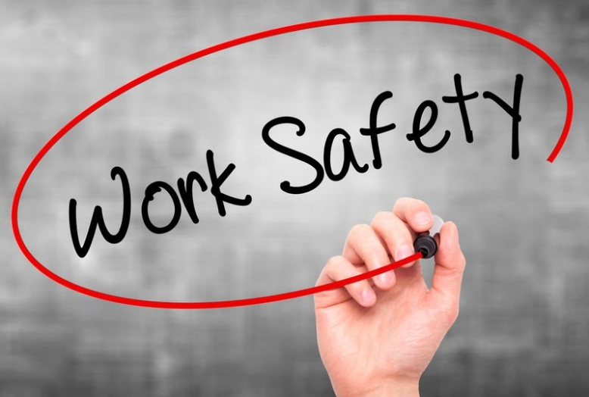
Work Health and Safety Act 2011
It provides the set of rights and responsibilities shared by employers and workers across various industries.
It serves as a national legal framework for ensuring the health and safety of all people in the workplace.
Under its Part 2, the employer has the primary duty of care to ensure the health and safety of all workers involved with the organisation.
Reflect on Your Perspectives

Slide 102
Clients also have responsibilities when accessing and utilising your services.
The general duties of clients may involve the following:
Respecting the rights of employees
Treating employees without discrimination
Abiding by the terms of a written agreement
Accepting responsibility for own actions and choices, even though some actions and preferences may involve an element of risk
Reflect on Your Perspectives

Slide 103

You may need to remind the clients of their rights and responsibilities. It is also best to remind your employees to uphold their rights and adhere to their responsibilities.
The act contains many important clauses that provide the rights and responsibilities of employers, workers and clients.
Reflect on Your Perspectives

Slide 104
Some of them are provided below:
Relevant party | Clause
Relevant to the employer | A person conducting a business or undertaking at a workplace may establish a health and safety committee for the workplace or part of the workplace on the person’s initiative. The person conducting a business or undertaking must, so far as is reasonably practicable, consult, in accordance with this Division and the regulations, with workers who carry out work for the business or undertaking who are or are likely to be directly affected by a matter relating to work health or safety.
Reflect on Your Perspectives

Slide 105
Some of them are provided below:
Relevant party | Clause
Relevant to the worker | A worker may cease or refuse to carry out work if the worker has a reasonable concern that carrying out the work would expose the worker to a serious risk to the worker’s health or safety emanating from immediate or imminent exposure to a hazard. A worker who ceases work under Division 9 of this legislation must (a) as soon as practicable, notify the person conducting the business or undertaking that the worker has ceased work under this Division unless the worker ceased work under a direction from a health and safety representative, and (b) remain available to carry out suitable alternative work.
Reflect on Your Perspectives

Slide 106
Some of them are provided below:
Relevant party | Clause
Relevant to the client | Clients must be able to view any notices of provisional improvement. A person at a workplace (whether or not the person has another duty under this Part) must take reasonable care for his or her health and safety and take reasonable care that his or her acts or omissions do not adversely affect the health and safety of other persons, and comply, so far as the person is reasonably able, with any reasonable instruction that is given by the person conducting the business or undertaking to allow the person conducting the business or undertaking to comply with this Act.
Reflect on Your Perspectives

Slide 107
In the table below, you can see the general responsibilities of workers and employers.
Responsibilities of Workers | Responsibilities of Employers
Avoiding work practices that are harmful to the health and safety of yourself or others | Ensuring a safe work environment and providing protective equipment if necessary
Knowing what to do if the employer is not meeting their responsibilities | Ensuring that workers are free from discrimination and bullying
Knowing and understanding the terms and conditions of employment | Ensuring that workers receive all due entitlements
Reflect on Your Perspectives

Slide 108
Here are some other common ethical rights and responsibilities.
Relevant to the Worker:
Rights and Responsibilities | Action or response for when these are not upheld or met in the workplace
The worker retains the right to maximise his or her potential. | They may be advised to submit a complaint to their human resources department.
The worker has an obligation to treat clients with dignity. This obligation includes safeguarding, promoting and acknowledging their capacity for self-determination. | Violations of this duty are subject to penalties and corrective action in the organisation’s policy.
Reflect on Your Perspectives

Slide 109
Relevant to the Employer:
Rights and Responsibilities | Action or response for when these are not upheld or met in the workplace
Employers enjoy the right to expect all workers to carry out the duties and responsibilities of the role as outlined in their terms of employment. | Employers reserve the right to perform investigations and conduct disciplinary hearings to address worker performance issues. The investigations and hearings must not detract from the worker’s productivity and earning potential. In addition, the workers’ rights must be protected throughout the ordeal.
Reflect on Your Perspectives

Slide 110
Relevant to the Employer:
Rights and Responsibilities | Action or response for when these are not upheld or met in the workplace
Employers are expected to respond to reports where organisational expectations or practices contravene the profession’s code of ethics - particularly in the area of client rights | There are cases where the employer or person conducting the business does not respond to a reported issue or concern. The employees retain the right to address issues to the best of their ability without the employer's express permission.
Reflect on Your Perspectives

Slide 111
Relevant to the Client:
Rights and Responsibilities | Action or response for when these are not upheld or met in the workplace
Every client is legally protected against discrimination on the basis of age, sex, race and disability. Their universal human rights are inviolable. | Clients reserve the right to submit complaints regarding any negative experiences. Complaints must be submitted through proper channels.
It is the responsibility of all clients to respect the rights and legal protections of others. | The organisation reserves the right to deny service to clients who breach any of the organisation’s policies and procedures. The authorities may be involved in cases where clients’ actions pose a danger to themselves, other clients, employees and any person under the organisation's care.
Reflect on Your Perspectives

Slide 112
Try to ask yourself the following questions to reflect on your current level of ability:
Have I read through the different sources of legal and ethical considerations that apply to my line of work?
Do I use practices that are aligned with these legal and ethical considerations?
Am I capable of performing all of my responsibilities as a worker?
Am I aware of my rights and what to do when these rights are not upheld or met in the workplace?
When talking to a worker, employer or client, can I satisfactorily explain their rights and responsibilities?
Am I capable of doing the right thing, given any situation?
Am I ready to contribute to an inclusive workplace?
Reflect on Your Perspectives

Slide 113

1.4 Improving Yourself and Your Social Awareness

Slide 114
You should now have a good grasp of your awareness and abilities through your reflections and have an idea of what you need to improve on, such as:
Your attitudes and beliefs about diverse people
Your knowledge of concepts relevant to inclusion
Your rights and responsibilities, as well as that of others
Your work practices and how these must comply with different legal and ethical requirements
Your overall awareness when it comes to working with diverse people
Reflect on Your Perspectives

Slide 115
Improving Yourself
It must always be guided by the value of inclusion since it will affect how you perform in the workplace and how you interact with and form opinions on diverse people in everyday life.
When working on improving yourself, follow these five basic principles:
Have a realistic goal
Tap into existing resources
Progress is key
Be yourself
Have discipline
Reflect on Your Perspectives

Slide 116
Improving Your Cultural Awareness
You need to adjust and allow different cultures to interact and engage differently by using consultation and negotiation to ensure all needs are met.
When consulting with persons from different backgrounds, you can follow these guidelines:
Understand that you do not fully understand
Network with multicultural agencies
Broaden your concept of family
Reflect on Your Perspectives

Slide 117

When consulting with persons from different backgrounds, you can follow these guidelines:
Address issues that the client may have about government agencies
Express genuine inquisitiveness
Learn and use culturally appropriate resources
Be patient
Understand silence and respect
Reflect on Your Perspectives

Slide 118

When consulting with persons from different backgrounds, you can follow these guidelines:
Make an effort to always give something back.
Do not make impossible promises or suggest outrageous outcomes.
People skills are important.
Avoid direct eye contact, as a general rule.
Upon initial contact, be thoughtful.
Reflect on Your Perspectives

Slide 119
Additional strategies to accommodate cultural differences in the workplace may include:
Holding workplace induction programs
Complying with existing human rights standards and goals, including creating effective remedies in cases of human rights breaches
Prohibiting and eliminating all forms of discrimination in the preservation of rights
Prioritising people who came from marginalised and vulnerable groups
Involving employees in the decision-making process
Using general guidelines and standards for approaching specific tasks and issues
Understanding the Code of practice at all levels of the organisation
Reflect on Your Perspectives

Slide 120
Additional strategies to accommodate cultural differences in the workplace may include:
Setting time to reflect on actions and events to make and maintain cross-cultural relationships
Setting time to reflect on oneself before working in a cross-cultural context
Reaffirming the organisation’s commitment to extend human rights by following the anti-discrimination policies ensuring that fair sanctions are provided in cases of violation.
Educating workers on their rights, why they matter, and how they are protected.
Coordinating with relevant authorities that uphold the safety and well-being of all employees
Ensuring that policies and procedures implemented in the workplace are consistent with the state/territory human rights legislation and the national quality standard
Reflect on Your Perspectives

Slide 121

What have we learned?
In this part of the session, we have covered:
Reflect on your perspectives
Appreciate diversity and inclusiveness, and their benefits
Communicate with people from diverse backgrounds and situations
Promote understanding across diverse groups

Slide 122
End of Chapter 1

